Slide 1

NYPD Shooting Incidents
Data Analysis University of Colorado Boulder - Burak

Slide 2
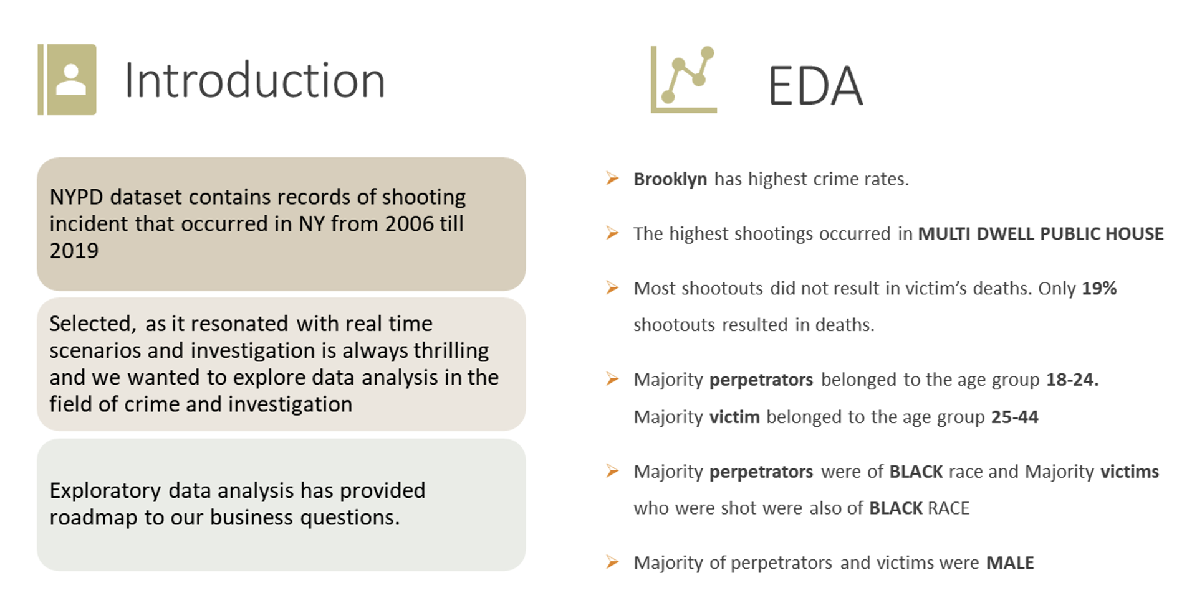

Slide 3
Preliminary Analysis and Questions
Data Analysis University of Colorado Boulder - Burak

Slide 4
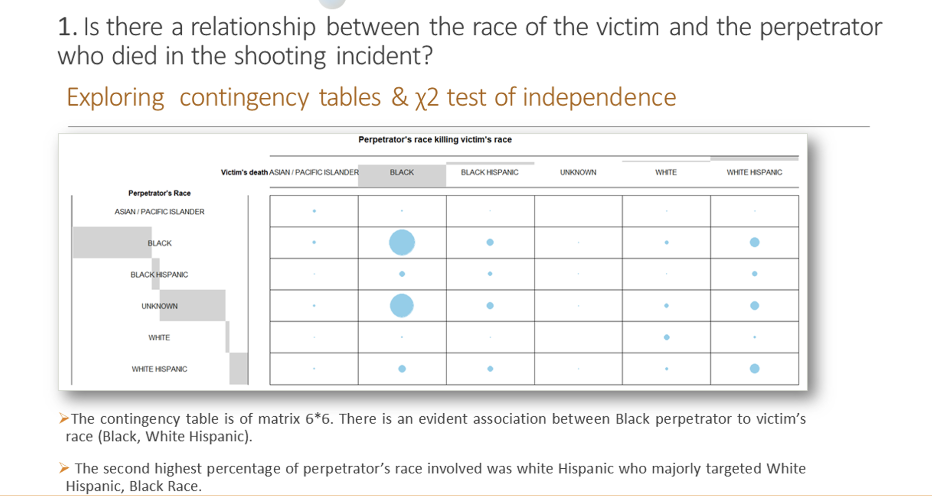

Slide 5
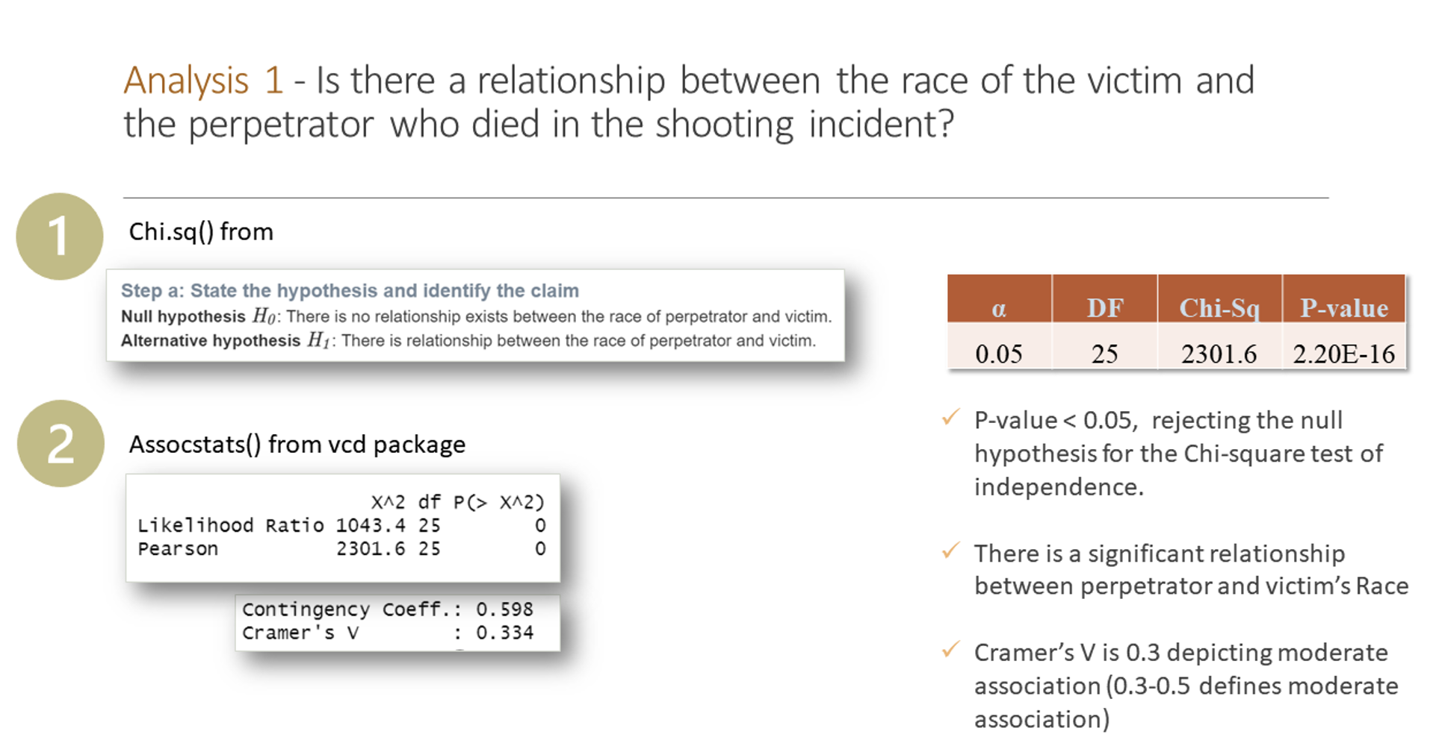

Slide 6
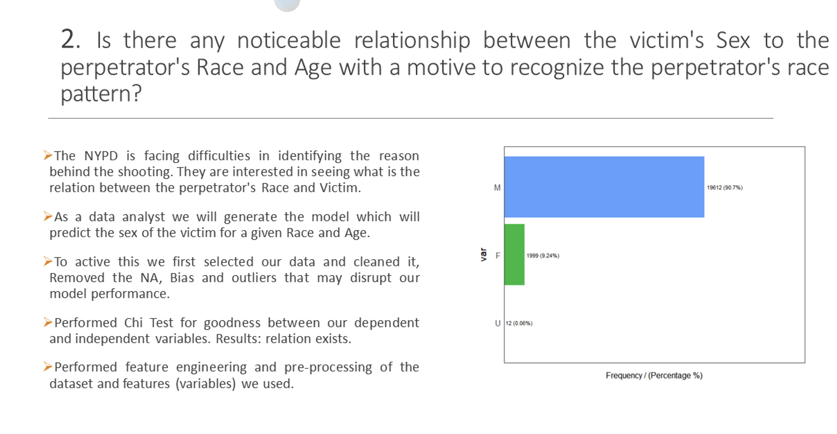

Slide 7
Thank you!
Data Analysis University of Colorado Boulder - Burak

